Slide 1

Redundant Loads: A Software Inefficiency Indicator
Pengfei Su, ShaSha Wen
Hailong Yang
Milind Chabbi
College of William & Mary
Beihang University
Scalable Machines Research
Xu Liu
College of William & Mary

Slide 2
Software Inefficiencies
According to provenance, software inefficiencies include
Data structure/algorithm-related inefficiencies
Input-related inefficiencies
Compiler-related inefficiencies
massive
cache misses
unnecessary
computation/data moving
excessive
synchronization
…

Slide 3
Software Inefficiencies
Data structure/algorithm-related inefficiencies
Parsec dedup
hash_entry *linkedList_hashtable_search(hashtable *h, void *k) {
…
while (NULL != e) {
if ((hashvalue == e->h) && (h->eqfn(k, e->k))) return e;
e = e->next;
}}
Hash table
Buckets utilization: 2%
Symptom: repeatedly load same value from same memory location
Optimization: make hash keys uniformly distributed among buckets
Speedup: 11%

Slide 4

Software Inefficiencies
Input-related inefficiencies
Rodinia backprop
1 for (j = 1; j <= ndelta; j++) {
2 if (delta[j] == 0) continue;
3 new_dw = ETA*delta[j];
4 w[k][j] += new_dw;
5 }
1 for (j = 1; j <= ndelta; j++) {
2 new_dw = ETA*delta[j];
3 w[k][j] += new_dw;
4 }
Optimization
Symptom: repeatedly load same value (i.e., zero) from adjacent locations (i.e., array delta[])
Optimization: conditional check before after line 2 to bypass unnecessary computation
Speedup:13%

Slide 5
Software Inefficiencies
Compile-related inefficiencies
SPEC CPU2006 464.h264ref
for (blky = 0; blky < 4; blky++) {
for (y = 0; y < 4; y++) {
refptr = funcPtr(…, img_height, img_width);
}}
Symptom: funcPtr() repeatedly loads (pops) same value from same stack location
Optimization: Inline funcPtr() in its caller
Speedup: 28%
Software inefficiencies often manifest as redundant memory loads

Slide 6
Load Redundancy
Temporal load redundancy
Two consecutive loads load same value from same memory location
… = a[42]
…
… = a[42]
Spatial load redundancy
Two consecutive loads load same value from adjacent locations (same data object)
a = {3,3,3,5,5,5,…}
for(i=0; i<M; ++i) sum += sqrt(a[i]);

Slide 7
Load Redundancy
Temporal load redundancy
Two consecutive loads load approximately same value from same memory location
… = a[42]
…
… = a[42]
Spatial load redundancy
Two consecutive loads load approximately same value from adjacent locations
a = {3,3,3,5,5,5,4,4,…}
for(i=0; i<M; ++i) sum += sqrt(a[i]);

Slide 8
LoadSpy Overview

Slide 9
LoadSpy: Temporal Load Redundancy Detection
Intercept every memory load
On a memory load
old value
Get the value before the load
=?
yes, redundant
new value
Get the value after the load

Slide 10
LoadSpy: Spatial Load Redundancy Detection
Intercept every memory load
Obtain data object’ address range
On a memory load
Static object: Access symbol table
Dynamic object: Intercept malloc() family of functions and mmap()
Data object table
Object | Previous load
Array a | a[i]
… | …
Current load
a[i] = a[j]?
yes
Memory access sequence
… | … | a[i] | a[j] | … | …
Redundant
Array a

Slide 11



LoadSpy: Redundancy Attribution
main()
A()
E()
old context (${load}_{old}$)
new context ($C_{{load}_{new}}$)
B()
D()
F()
C()
add
old value
new value
old operation
<redundant with>
current operation
Redundancy pair: <($C_{{load}_{old}}$ , $C_{{load}_{new}}$), frequency>
"Call Paths for Pin Tools”,(CGO 2014)
http://www.cs.wm.edu/hpc/cctlib-cgo17/

Slide 12
LoadSpy: Redundancy Scope Detection
Redundancy scope
Implies in which loop (if any) redundancy happens
Identified by employing static interval analysis and a timestamp counter
for(i=0; i<M; ++i)
for (k=0; k<N; ++k) t += a[k];
for(i=0; i<M; ++i)
for (k=0; k<N; ++k) t += a[k];
Redundancy occurs in the inner loop
Redundancy occurs in the outer loop

Slide 13
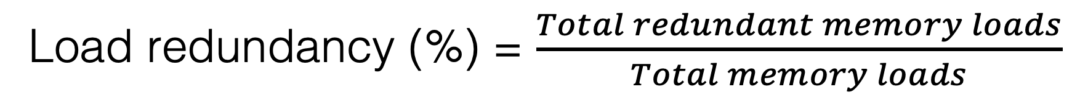
Experiments
Load redundancy On SPEC CPU2006
GCC-4.8.5 –O3 PGO (profile-guided optimization)
Temporal load redundancy
Spatial load redundancy
Load redundancy (%) = $\frac{Total redundant memory loads}{Total memory loads}$

Slide 14
Experiments
Time overhead on SPEC CPU2006
Temporal load redundancy detection
Spatial load redundancy detection

Slide 15
Case Study
Program |  | Inefficiency | Optimization | Speedup
Macro benchmark | 359.botsspar | Inefficient register usage | Scalar replacement | 1.77
 | 453.povray | Missing inline substitution | Function inlining | 1.05
 | 464.h264ref | Missing inline substitution | Function inlining | 1.28
 | 470.lbm | Redundant computation | Approximate computing | 1.25
 | 538.imagick_r | Redundant computation | Conditional computation | 1.25
 | backprop | Input-sensitive redundancy | Conditional computation | 1.13
 | hotspot3D | Inefficient register usage | Scalar replacement | 1.13
 | lavaMD | Redundant function calls | Reusing the previous result | 1.39
 | srad_v1 | Inefficient register usage | Scalar replacement | 1.11
 | srad_v2 | Inefficient register usage | Scalar replacement | 1.12
 | particlefilter | Linear search | Binary search | 9.8
 | vacation | Redundant function calls | Reusing the previous result | 1.24
 | dedup | Poor hashing | Reducing hash collisions | 1.11
 | msgrate | Missing constant propagation | Copy propagation | 3.03
Real application | Apache Avro | Missing inline substitution | Function inlining | 1.19
 | Hoard | Redundant computation | Reusing the previous result | 1.14
 | MASNUM | Linear search | Locality-friendly search | 1.79
 | USQCD Chroma | Missing inline substitution | Function inlining | 1.06
 | Shogun | Missing inline substitution | Function inlining | 1.06
 | Stack RNN | Redundant computation | Conditional computation | 1.09

Slide 16
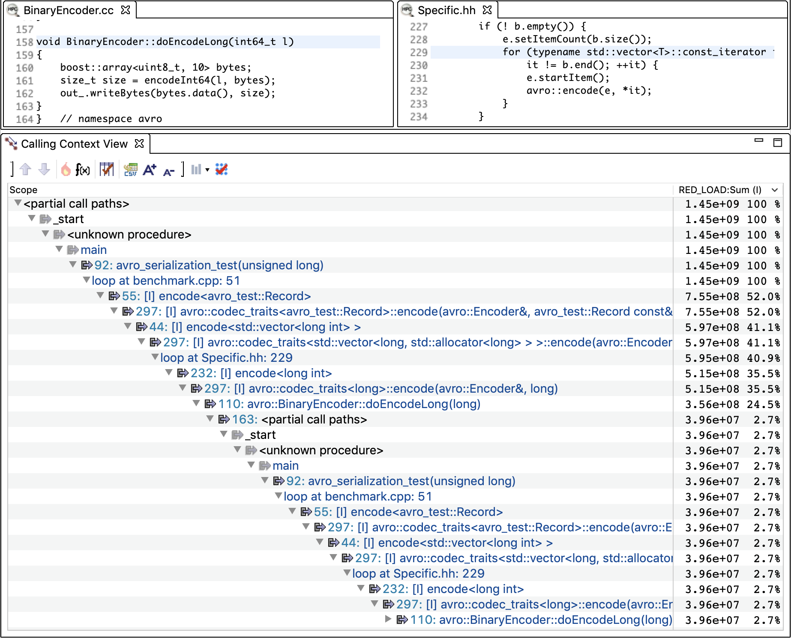


Case Study: Apache Avro
A RPC and data serialization processing system
Missing function inlining
Redundancy scope
frequency
[I]: inlined
Old calling context ($C_{{load}_{old}}$)
New calling context ($C_{{load}_{new}}$)

Slide 17
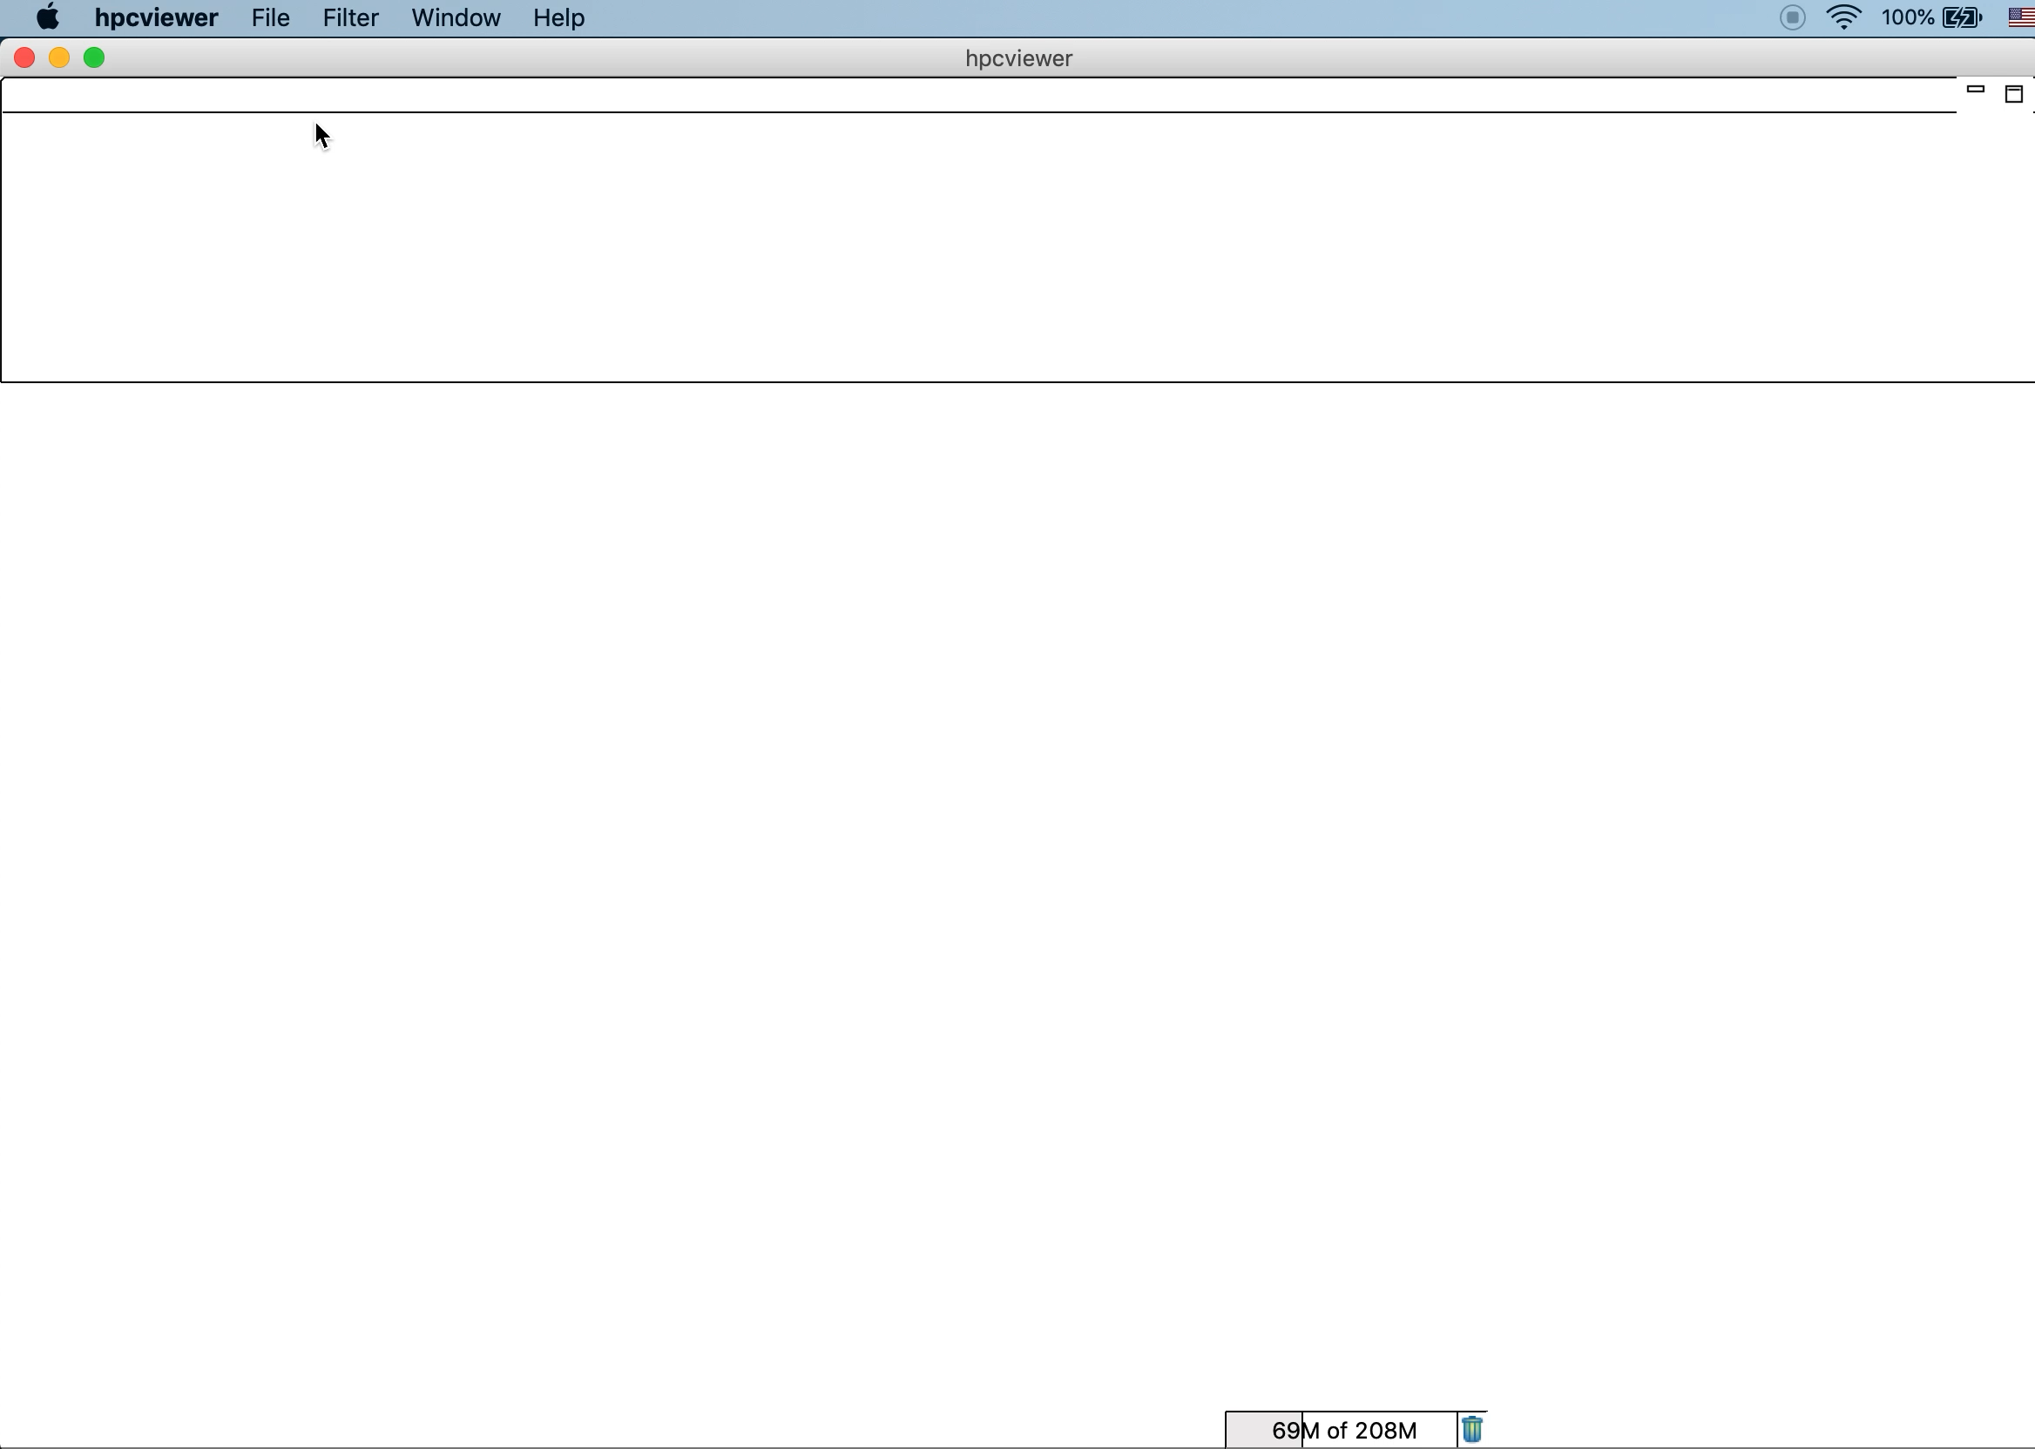
Case Study: Apache Avro

Slide 18
Conclusions
Many kinds of software inefficiencies manifest as redundant memory load operations
E.g., algorithms, data structures, implementation choices, compiler transformations
We developed LoadSpy -- a tool to pinpoint and quantify redundant load operations
LoadSpy
Automates important use cases to help developers investigate load redundancy
Opens a new avenue to tune software for high performance
Under MIT License at https://github.com/CCTLib
Questions?

